Slide 1
Game Co Videogame Sales Analysis for Marketing budget 2017
Sruthy Sreekanth

Slide 2

Agenda
Objective
GameCo’s Assumption
Global & Regional Sales Analysis
Gaming market-2016
Insights from Data
Budget for Marketing in 2017: Recommendations
Summary

Slide 3

Objective
Analyze the video game sales data up to October 2016 and provide the executive board of Game Co. insightful information to help them plan their marketing budget for 2017.
Understand the prevailing gaming trends and the future outlook for the gaming business.
Data from 1983 to 2016 were analyzed

Slide 4

GameCo’s Assumption
The executive committee of Game Co. is planning the 2017 marketing budget. They assume that over time, videogame sales have remained constant across all regions.

Slide 5

Global Sales Analysis
By Year
By Region
By Genre
By Platform

Slide 6
Global sales by Year
From 1983 to 2016, the flow of overall sales is depicted in this visualization.
Since 2008, there has been a decline in global sales.
The primary cause is the declining trend in North American sales.

Slide 7
Global sales by Region
It displays the proportion of global sales by geographical region.
From 1983 to 2016, about half of all sales worldwide came from North America.
The North America has the highest proportion of Global sales (49%).
Japan has the lowest proportion of Global sales (14%) (14%)

Slide 8
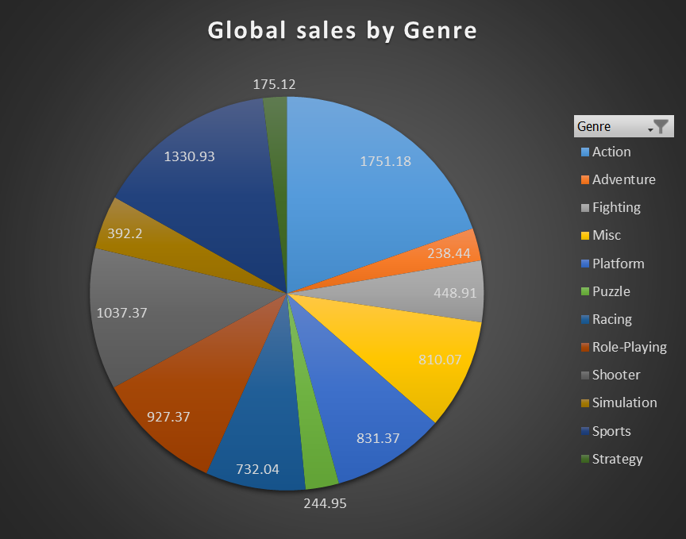
Global sales by Genre
From 1983 to 2016, It represents the game types that sold the most units.
Top 5 Genres across Global
Action
Sports
Shooter
Role-playing
Platform

Slide 9
Global sales by Platform
It provides an overview of platform’s level of popularity.
Top 5 Platforms across Global
PS2
X360
PS3
Wii
DS

Slide 10
Regional Sales Analysis
By Year
By Genre
By Platform

Slide 11
Regional sales by Year
Between 1983 and 2016, It illustrates the percentage of global sales by region
For the majority of the years, North America had the highest sales figures, however, there has been a decline in recent years.
Since the beginning of the years, European sales have been steadily increasing, and in 2016, the European market overtook the North American market.
Japan's sales have increased somewhat in recent years.

Slide 12
Regional sales by Genre
With the exception of role-playing games, North America seems to be the market leader in terms of sales.
Japan has the largest Role-Playing game sales overall.

Slide 13
Regional Representation by Top Genres in Graphics
Top 3 popular Genre in NA
Action
Sports
Shooter
Top 3 popular Genre in EU
Action
Sports
Shooter

Slide 14
Top 3 popular Genre in JP
Role-Playing
Action
Sports
Top 3 popular Genre in Other Regions
Action
Sports
Shooter

Slide 15
Regional sales by Platform
It displays the percentage of sales in various regions using different platforms in recent years, from 2010 to 2016.

Slide 16
Regional Popularity Represented Graphically by Platform
Top 3 popular Platforms in NA
X360
PS2
Wii
Top 3 popular Platforms in EU
PS3
PS2
X360

Slide 17
Top 3 popular Platforms in JP
DS
PS
PS2
Top 3 popular Platforms in Other Regions
PS2
PS3
X360

Slide 18
Gaming Market -2016
Global Sales-2016
Regional sales-2016

Slide 19
Global Sales-2016
Ranking in Global Sales
European Market
North American Market
Japanese Market
Other Regions
Top 3 Genre in 2016
Action
Shooter
Sports
Top 3 platform in 2016
PS4
XOne
3DS

Slide 20
Regional Sales- 2016
In 2016, the European market had the highest sales, followed by the North American market.
Top 3 Genres in 2016
NA – Shooter, Action, Sports
EU – Shooter, Sports, Action
JP – Action, Role-playing, Adventure
Other – Shooter, Action, Sports
Top 3 Platforms in 2016
NA – PS4,Xone,Wiiu
EU – PS4,Xone,PC
JP – 3DS,PS4,PSV
Other – PS4,3DS,XOne

Slide 21
Insights from Data
Since 2008, global sales of video games have been steadily declining.
Sales in North America have been heading down recently, while sales in Europe and Japan have been trending up.
From 1983 to 2016, European Sales have increased at a comparatively constant rate.
Positive correlations exist throughout all geographic areas, with Japan having the lowest correlation to worldwide sales.

Slide 22
Budget for Marketing in 2017: Recommendations
The worldwide gaming industry is in a downward trend, and regional video game sales are not consistent over time.
Although there has been a decline in sales in recent years, North America has had the highest numbers of sales for most of the years and will continue to do so. Therefore, Game Co. should look into the reasons behind the fall in game sales in North America.
Consider the European market to be the video game market with the most potential for sales and allocate funds appropriately.
Concentrate on the genres that are most popular locally. Budgeting for action, sports, and shooter games should take precedence over other genres. However, role-playing games receive greater funding in Japan.
The most popular gaming platforms are PS4 and XOne.

Slide 23
Summary
GameCo's assumption must be revised because it doesn't match the insights drawn from the data.
Data indicates that the gaming industry is on the decline.
The two regions with the highest correlation to worldwide sales are Europe and North America. The country with the lowest global sales correlation is Japan.
Based on sales, platform, and genre, each geographic area has a unique marketing recommendation that helps the marketing team in planning and allocating the marketing budget for 2017.
It is preferable to get more information from different locations and organize it according to region in order to examine the future of videogames more thoroughly.

Slide 24

Thank You

